Slide 1
Turing completeness and the Universal Turing Machine

Slide 2
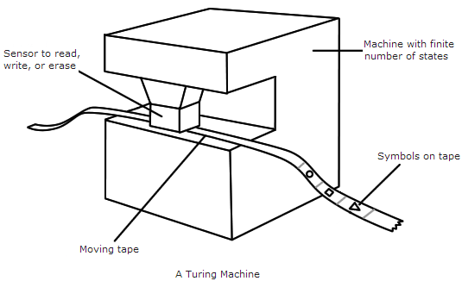
Turing Machines
Theoretical construct that can:
Read and write to memory
Move to another place in memory
Read and execute an instruction (states)
Hardware instructions
One Turing machine per function
Notes:
To review, a Turing machine is a theoretical construct. It has an infinite tape divided into cells with symbols, and a head. The head can move along the tape, read and write to a cell and contains finite instructions to determine what to change, where to move and when to stop.
These instructions/states are equivalent to an algorithm running on the input data.
Since software didn’t exist at the time, the ‘instructions’ would be thought of as part of the machine. This means a new Turing machine needed to be made for each function.

Slide 3
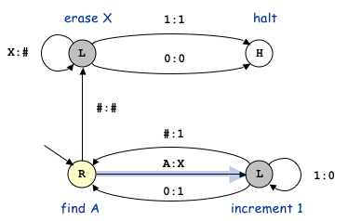
Turing Machines
0, 1, A, X, or #
L = Move Left 1 cell
R = Move Right 1 cell
Notes:
The possible states of a Turing machine can be represented as a state diagram, with each state being a possible configuration.
This example uses 0, 1, A, X, and # as its alphabet.
L and R indicate for the machine to move left or right.
When it reaches the halt state the program will stop and produce the output. Sometimes they have multiple exit states such as a True or False for decision problems, but this depends on the design.
The 2 letters indicates the input and what to replace it with.
This one requires only A’s as an input.
If we follow this logic: (PowerPoint) …
We have 6 As as input

Slide 4
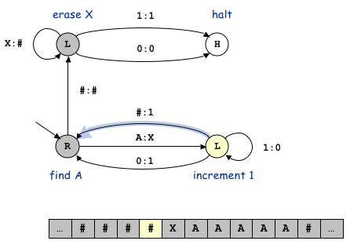
Turing Machines

Slide 5
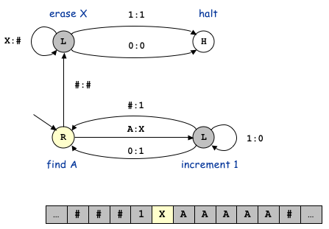
Turing Machines

Slide 6
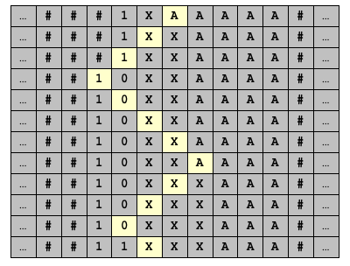
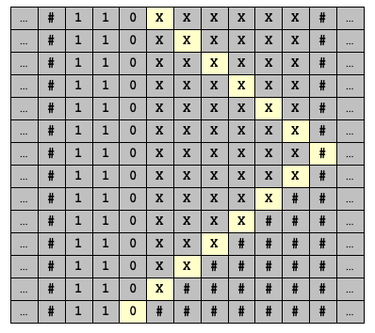
Turing Machines
What does this Turing Machine do?
Input:
#
Output:
Notes:
If we skip forward to when all the A’s are overwritten, the machine overwrites all the X’s with #’s till it halts.
In this example, it has turned 6 A’s into 110. Does anyone know what it does?
It turns unary (a system with one symbol) into binary.

Slide 7
Turing Machines
Natural numbers
Computability
Description Numbers
123334213241114323224344413242314
Notes:
Some other stuff to remember:
Turing machines work with natural number inputs and outputs
The functions expressed on a Turing Machine are computable functions, since there is an algorithm that can do the job.
Each individual Turing machine has a description number that identifies. In other words, the instructions/states that a Turing machine acts out are denoted a number.
The naming process for each machine depends on the input and output but it is not usually calculated.
The point is that a natural number could be interpreted as a description number for a Turing Machine even and that a number exists for a corresponding Turing machine.

Slide 8
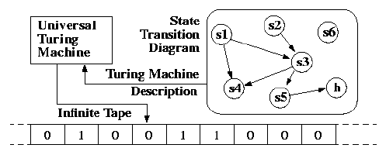
Universal Turing Machine
A Turing Machine that can simulate another Turing Machine
Takes an input tape and an encoded Turing Machine to simulate that Turing Machine
Notes:
Remember how a new Turing Machine needed to be created for each function, The Universal Turing Machine solves this problem.
The UTM is a Turing machine that can simulate any other Turing machine.
It takes the description number of the machine it is simulating and the input tape as the inputs.
Since the numbers are hard to usually identify a state diagram is put in place of it.
The UTM can be thought of as a computer and each Turing machine it simulates as a program or function.

Slide 9
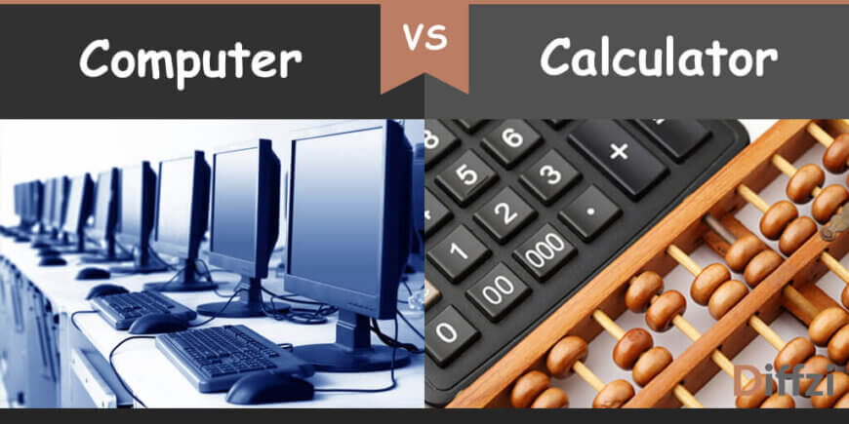
Turing Completeness
Something that can simulate a Universal Turing Machine
Run an algorithm
Arbitrary amount of memory
Turing Complete
Turing Incomplete
Notes:
This brings us to Turing Completeness. For something to be Turing Complete it must be able to do anything a Turing machine can or can simulate a Universal Turing machine.
This implies that it can manipulate data using conditional branching (run any algorithm) and have the memory required to solve the problem (a long enough tape).
Basically, something that can compute anything that can be computed, no matter how long it takes, is Turing complete.
Turing completeness can apply to hardware, like a computer, or software, a Virtual Machine.
For example, A calculator by itself Turing incomplete because it can only perform a small pre-defined subset of calculations.
However, a Mac or a PC is Turing complete because it can do any calculation that a Turing machine can do if we give it enough memory and time.
On the software side, SQL is not Turing Complete while Python is.

Slide 10
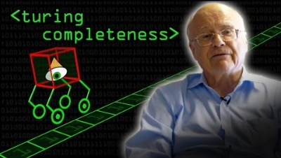

Slide 11
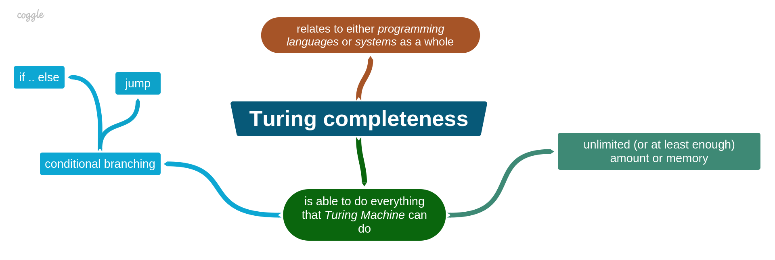
Practicality
Check Decidability
Classify Problems
Design and Implement Algorithms
Design of tools
Notes:
The applications of a UTM and Turing completeness allow us to:
Check Decidability
If UTM cannot compute a problem, then there is no algorithm that can solve that problem.
Classify Problem
UTM help to classify decidable problems into classes of Polynomial Hierarchy. P, NP etc…
Design and Implement Algorithm for Practical Machines
If we know it can be solved by a Turing machine and what class the problem is, then we know it can be solved on a computer and the appropriate algorithm to use.
This can then be extended to software and hardware tools. If we want to solve a set specific problems, determining if it requires Turing completeness or not can save a lot of time in design.
A more concrete application may be forewords and backwards compatibility. Meaning with a few software tweaks, you can play Mario Kart 64 without a Nintendo 64 or run a new game on your old computer (even if it’s slow) without upgrading.

Slide 12
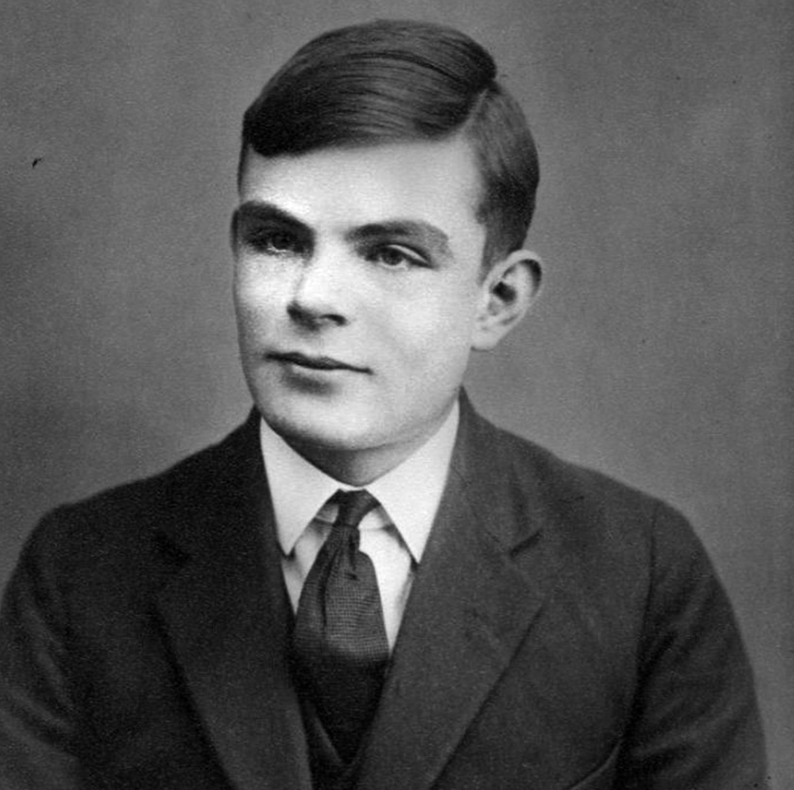
Current Limits
Nothing created today is Turing Complete
Not every problem is solvable
Our ability to create tools
Notes:
If we are being picky, nothing we have created today is Turing Complete. To be Turing Complete it requires the ability to access an arbitrary amount of memory. Every computer today has a limited amount of RAM and can’t access any more than what is available. Think of Turing Completeness as the ability to compute all computable problems in theory.
The limits of computation apply. The halting problem for example can’t be computed reliably for every input. This applies to every computer or computational device.
This also relates to how powerful tools we can create can be. If any Turing Complete thing can in theory run any function a UTM can then all Turing complete things are as powerful as each other. In the sense that they can all in theory solve the same problems and not solve the same problems. This links back to the computation point. Unless something paradigm shifting is discovered, any improvements in technology will speed up the time it takes to solve computable problems, and perhaps make some problems more feasible, but doesn’t solve problems previously incomputable. It says that there is nothing more powerful than a universal Turing Machine.
All of this assumes that the Church-Turing thesis is indeed correct.
(alt
For instance, the controversial field of Hypercomputation tackles the concept of incomputable numbers.
(We might hear more of this from another presentation so I wont go into it).
It requires the Church-Turing thesis to be wrong is either 3 ways:
There is a process that humans can do to calculate these numbers that computers cannot.
There are functions that machines can compute which humans cannot (given infinite time and memory)
There are instances in which incomputable numbers can be measured in nature rather than computed.
Many claim this field baseless, but it is still an interesting idea that the Thesis could be incorrect. )
All known laws of physics can be simulated by a series of approximate computable functions. This argues that the Universe can be run on a Universal Turing Machine.
If (the thesis was) false, it would say that the Universe doesn’t work like a Turing machine and would change our current understanding of the universe and what is possible with computers.

Slide 13
Bibliography
barkha. (2017). State and explain the power and limitations of a Turing machine. Retrieved August 30, 2021, from www.ques10.com website: https://www.ques10.com/p/19485/state-and-explain-the-power-and-limitations-of-a-t/
‌Computerphile. (2016). Turing Complete - Computerphile. Retrieved from https://www.youtube.com/watch?v=RPQD7-AOjMI
‌Johnson, S. (2008, June 16). On the importance of Turing completeness | Lambda the Ultimate. Retrieved August 30, 2021, from lambda-the-ultimate.org website: http://lambda-the-ultimate.org/node/2846
‌Priya, B. (2021, June 15). Explain the universal Turing machine in TOC. Retrieved August 24, 2021, from www.tutorialspoint.com website: https://www.tutorialspoint.com/explain-the-universal-turing-machine-in-toc
‌Sedgewick, R., & Wayne., K. (2017, June 30). Turing Machines. Retrieved August 26, 2021, from introcs.cs.princeton.edu website: https://introcs.cs.princeton.edu/java/52turing/
‌Sellin, E. (2017, January 11). What exactly is Turing Completeness? Retrieved August 25, 2021, from Medium website: https://evinsellin.medium.com/what-exactly-is-turing-completeness-a08cc36b26e2

